Slide 1

GA Crossover and Mutation
Professor Bo Liu
James Watt School of Engineering

Slide 2
The workflow of GA
Initialization
x ={x¹, …, x^{M}}
x_{mat}={x¹_{mat} , …, x^{M}_{mat}}
Selection
Crossover
x_{cross}={x¹_{cross} , …, x^{M}_{cross}}
Mutation
x_{mut}={x¹_{mut} , …, x^{M}_{mut}}
No
Replacement
Termination conditions?
Yes
Save the optimal solution

Slide 3
Crossover
New solutions are generated using the crossover and mutation operations.
These operators:
  act directly on the individuals
  are often used after selection
  in most cases, have no relation with the fitness

Slide 4
Crossover
In crossover operation, two individuals crossover with each other in some way.
Simple (One-Point) Crossover
K-Point Crossover
Before crossover
After crossover
1 0 0 0
1 0 0 1
0 1 0 1
0 1 0 0

Slide 5
Crossover
Simple (One-Point) Crossover
Two individuals (parents) are selected randomly from the mating pool.
The crossover site is randomly selected.
The children are generated by swapping.
Crossover Site (4)
Parent 1
1 0 0 1 1 0
Child 1
1 0 0 1 0 1
Parent 2
0 0 1 0 0 1
Child 2
0 0 1 0 1 0

Slide 6
Crossover
K-Point Crossover
K-point crossover selects k crossover sites and swaps the substrings between them.
Example (K=2):
Crossover Site (2)
Crossover Site (4)
Parent 1
1 0 0 1 1 0
Child 1
1 0 1 0 1 0
Parent 2
0 0 1 0 0 1
Child 2
0 0 0 1 0 1

Slide 7
Crossover
Crossover rate
The two parents from the mating pool undergo crossover with a (usually high) probability, P_{c}.
A random number R_{c} is generated in the range of 0-1, and the individuals undergo crossover if R_{c} ≤ P_{c}
Otherwise, the parents proceed without crossover and directly become offspring.
Typical values of P_{c} are 0.6 to 0.9

Slide 8
Crossover
Generation 0
Generation 1
i | x^{i} | G(x^{i}) | Prob (x^{i}) | Mating Pool | G(x^{i}) | Crossover Site | x^{i}_{cross} | G(x^{i}_{cross})
1 | 1011 | 56 | .55 | 1011 | 56 | Rc ≤ Pc 2 | 1010 | 61
2 | 0010 | 29 | .28 | 0010 | 29 |  | 0011 | 40
3 | 0001 | 16 | .16 | 1011 | 56
4 | 0000 | 1 | .01 | 0001 | 16

Slide 9
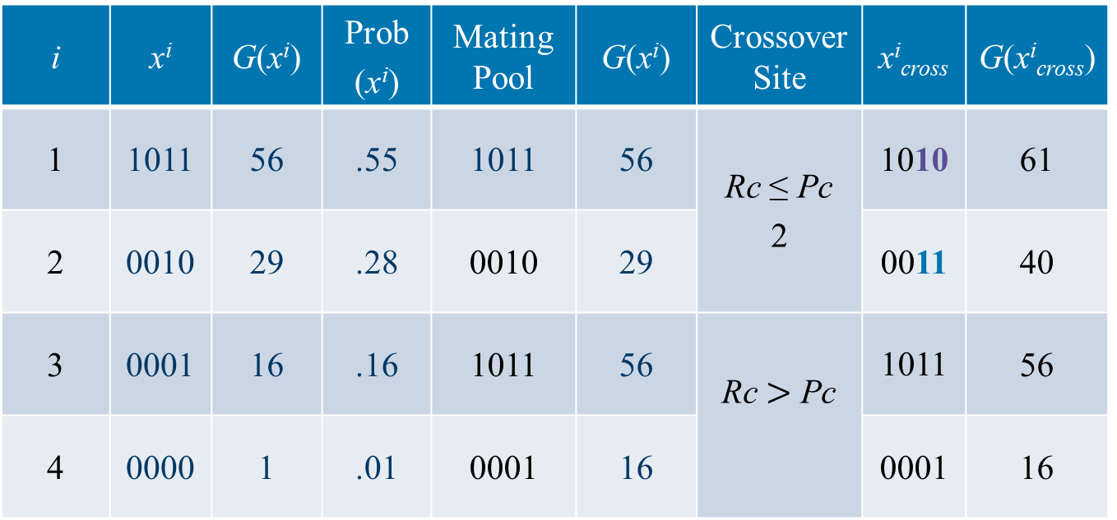
Crossover
Generation 0
Generation 1
i | x^{i} | G(x^{i}) | Prob (x^{i}) | Mating Pool | G(x^{i}) | Crossover Site | x^{i}_{cross} | G(x^{i}_{cross})
1 | 1011 | 56 | .55 | 1011 | 56 | Rc ≤ Pc 2 | 1010 | 61
2 | 0010 | 29 | .28 | 0010 | 29 |  | 0011 | 40
3 | 0001 | 16 | .16 | 1011 | 56 | Rc $>$ Pc | 1011 | 56
4 | 0000 | 1 | .01 | 0001 | 16 |  | 0001 | 16

Slide 10
Crossover
Effects of crossover
It may increase or decrease the average fitness with a limited number of samples.
Crossover increases diversity.
Mating Pool | G(x^{i}) | x^{i}_{cross} | G(x^{i}_{cross})
1011 | 56 | 1010 | 61
0010 | 29 | 0011 | 40
1011 | 56 | 1011 | 56
0001 | 16 | 0001 | 16

Slide 11
Crossover
Crossover & Premature Convergence
In some cases, crossover cannot generate new individuals, as shown below:
0 0 | 0 1
0 0 | 0 0
0 0 1 | 0
0 0 1 | 1
0 0 | 0 0
0 0 | 0 1
0 0 1 | 1
0 0 1 | 0
Selection + crossover cannot solve the problem on some occasions.

Slide 12
Mutation
After crossover, a gene mutation occurs in one of the individuals
A small probability to mutate (P_{m}≈ 0.001~0.01).
There are many mutation strategies.
In a binary string, with mutation rate, P_{m}, change a 0 to 1 or vice versa
Generating new individuals (guaranteed).

Slide 13




Thanks!
#UofGWorldChangers
@UofGlasgow

